Slide 1
COLLEGE ADMISSION ai agent
IBM SKILL BUILD PROJECT
Presented By
Student name : YOGIN N C
College Name & Department : BMSIT&M , MCA Department

Slide 2
OUTLINE
Problem Statement
Technology used
Wow factor
End users
Result
Conclusion
Git-hub Link
Future scope
IBM Certifications

Slide 3
Problem Statement
The college admission process involves numerous queries related to eligibility, fees, courses, and deadlines
Traditional methods of addressing inquiries (manual responses, email queries) are time-consuming and prone to delays. Students often face difficulty accessing accurate, up-to-date admission information.
There is a need for an intelligent system that can
Retrieve admission-related data from trusted institutional sources. Provide instant, accurate, and natural language responses to students.

Slide 4
Technology used
IBM Cloud Lite Services Cloud Object Storage (for storing documents and datasets)
Watsonx.ai Runtime (for AI model execution)
IBM Granite LLM (Foundation Model for text generation)
Retrieval-Augmented Generation (RAG)Combines document retrieval with AI reasoning for context-based answers

Slide 5
IBM cloud services used
IBM Cloud Watsonx AI Studio
IBM Cloud Watsonx AI runtime
IBM Cloud Agent Lab
IBM Granite foundation model

Slide 6
Wow factors
Real-time, document-aware Q&A using institutional data
Powered by Granite, IBM’s large language model optimized for enterprise AI
Supports natural language queries without requiring technical knowledge
Retrieves the most relevant, trusted, and updated admission details instantly
Can handle multiple queries simultaneously, improving efficiency
Scalable and adaptable for any institution's database

Slide 7
End users
Prospective Students – Quick access to course and admission info
Parents/Guardians – Fee structure and process clarification
College Admission Offices – Reduced manual inquiry load
Counselors/Education Consultants – Up-to-date admission guidelines
International Applicants – Accessible answers without time zone barriers

Slide 8
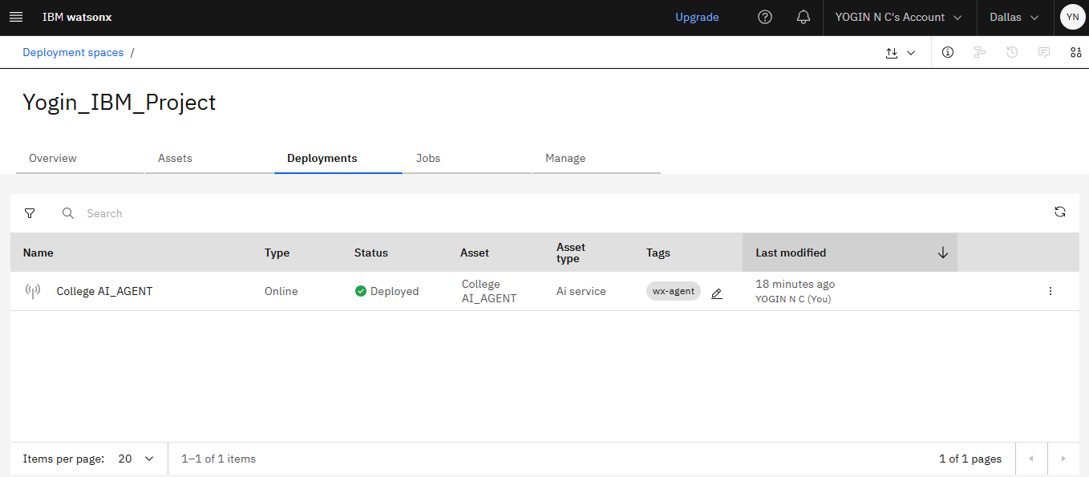
Results
Deployment of the AI Agent

Slide 9
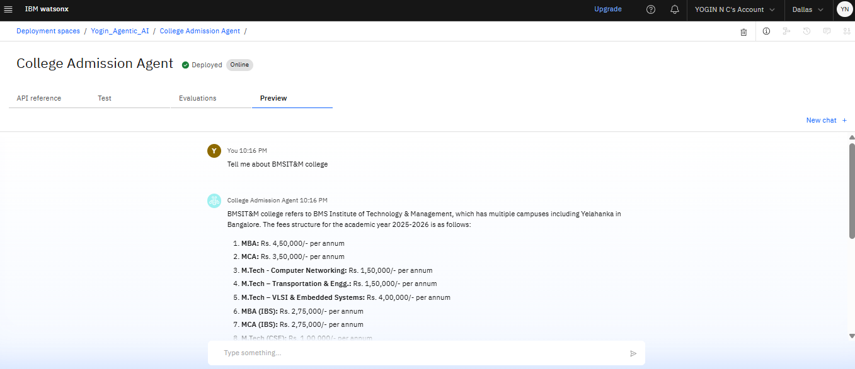
Results
Testing AI AGENT after Deployment

Slide 10
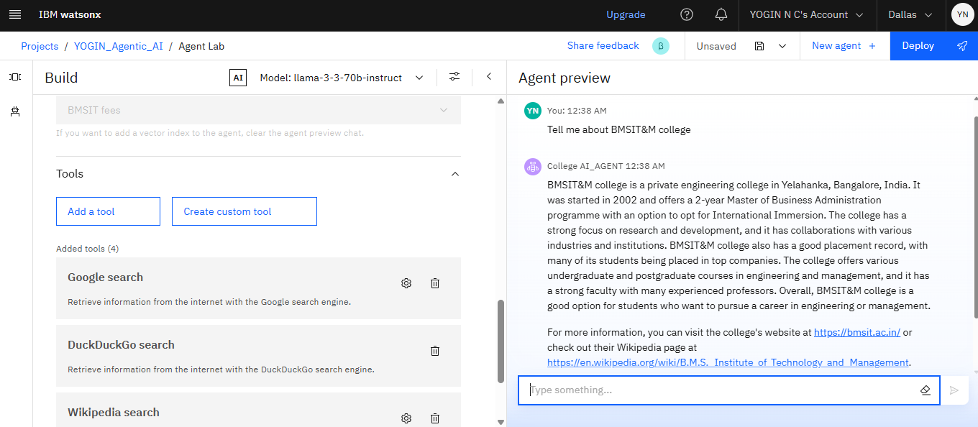
Results
Building of the AI Agent

Slide 11
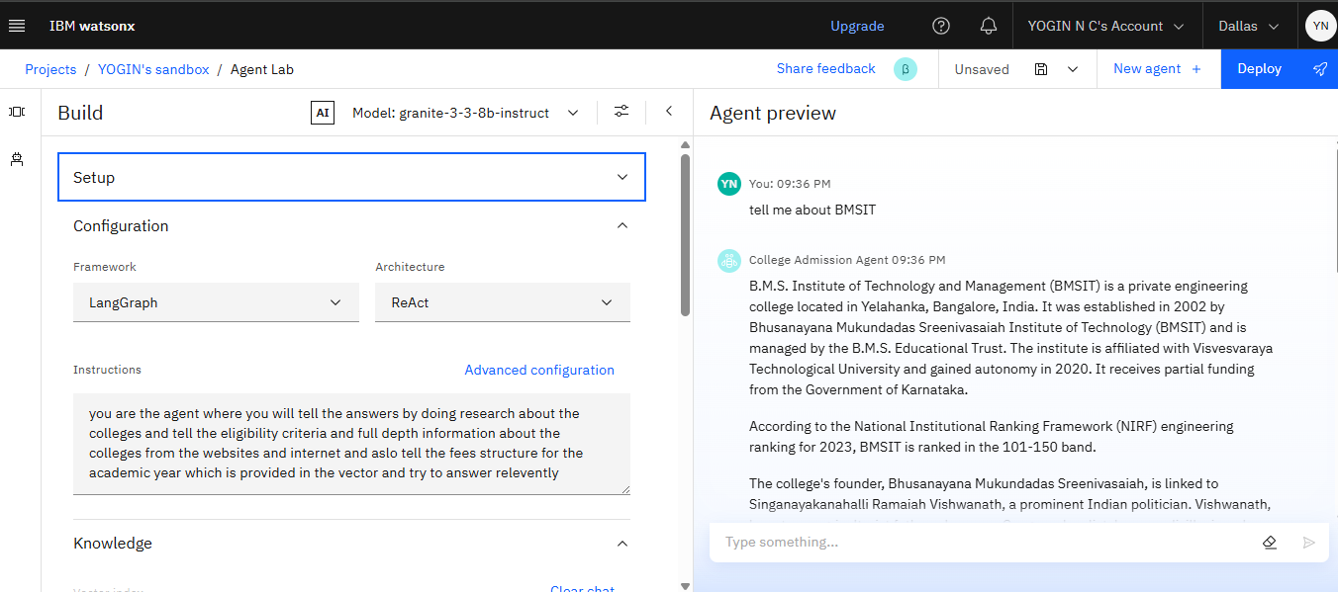
Results
Building and testing of the AI Agent using IBM Granite LLM model

Slide 12
Conclusion
Successfully deployed an AI-driven admission assistant on IBM Cloud
Integrated RAG pipeline with Granite LLM to retrieve answers from official documents
Reduced average response time for queries from hours/days to seconds
Provided consistent and accurate answers from verified sources
Improved transparency in the admission process

Slide 13
GitHub Link
https://github.com/Yoginsjce/IBM-edunet-internship

Slide 14
Future scope
Integrate multi-language support for regional and international applicants.
Add voice-based interaction for accessibility.
Expand to course recommendations based on student profile.
Enable real-time application status tracking.
Connect to external education databases for scholarship and exam updates.

Slide 15
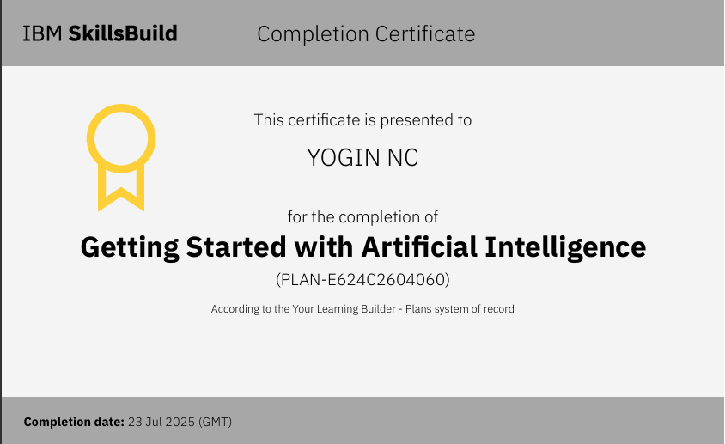
IBM Certifications

Slide 16
THANK YOU

